Slide 1
Sensation seeking and adolescent alcohol use: exploring the mediating role of unstructured socializing with peers
Sharon Sznitman & Batya Engel-Yeger

Slide 2
Conflict of interest
None
This work was supported by a research grant from the Israeli Anti-Drug Authority (grant number: 45771)

Slide 3
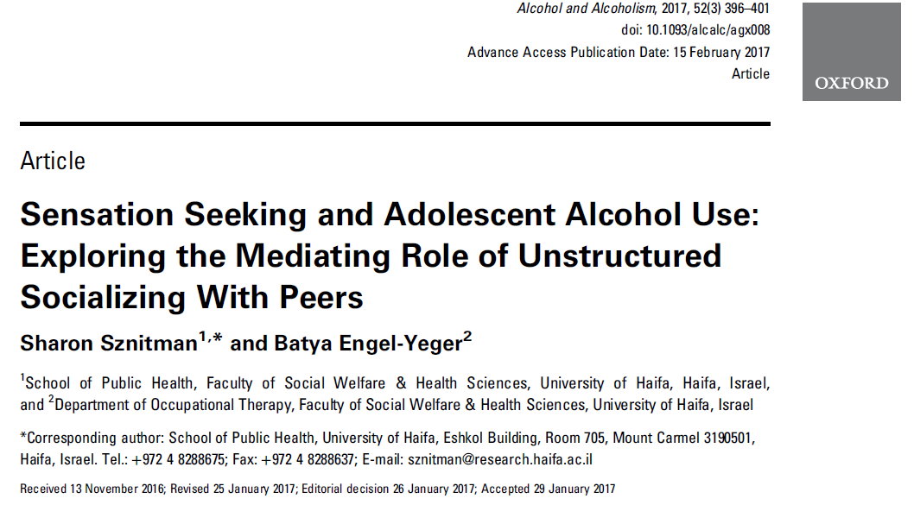

Slide 4
Heavy and frequent use of alcohol among adolescents – why should we care?
Poor academic achievement
Injuries and violence
Sexual risk behavior
Later alcoholism
Early mortality

Slide 5
Prevention
After school and community based prevention programs may be a way forward, but…
Few after-school programs have been developed
Of those that have been developed preventive effects are typically small and short lived
Before moving forward with novel prevention programs there is a need for a comprehensive understanding of modifiable factors that influence adolescent alcohol use

Slide 6
Risk factors: personality vulnerability
Sensation seeking:
A preference for novel and intense activities
Particularly sensitive to positive reinforcement and the rewarding outcomes of alcohol use
Sensation seeking is thereby theorized as a direct causal risk factor for the use of alcohol
Sensation seeking
Alcohol use

Slide 7
Risk factors: unstructured social activities
Hanging out, going to a party, spending time at friend’s house
No authoritative figures who monitors behaviors (parent, teacher, coach)
Over-represented by deviant and older adolescents
Research has shown that participation in unstructured activities is a risk factor for adolescent alcohol use and abuse (Eccles et al., 2003; Trainor et al., 2010; Wilson et al., 2010)

Slide 8
Risk factors:
unstructured social activities & sensation seeking
In alcohol research one often overlooked area is that sensation seekers may not only be prone to alcohol use
They may also be particularly likely to be involved in unstructured activities because of their impulsiveness and need for excitement
makes spontaneous, self-initiated and unsupervised activities especially appealing

Slide 9
Hypothesis:
Rather than functioning as a direct causal effect, sensation seeking increases risk of alcohol use through its effect on participation in unstructured social activities
Unstructured socializing
Sensation seeking
Alcohol use

Slide 10
Research question
Does participation in unstructured activities mediate the association between sensation seeking and adolescent alcohol use?

Slide 11
Methods
Cross sectional survey distributed during school hours in 1 Israeli state-secular Jewish high school (10th to 12th grade) in the center region of Israel
All classrooms were sampled
N= 360
51.5% boys
Age 15 -18 (mean=16.02±.85)

Slide 12
Measures:
Sensation seeking: how much do you agree with the following statements about yourself: “I would like to skydive”, “I am interested in experience for its own sake even if it is illegal”, “I like doing things that frighten me a little”. Scale: 1= strongly disagree - 4=strongly agree (reliability .70)
Unstructured socializing with peers: how often do you participate in any of the following unstructured activities: partying, hanging out and going to friends’ home. Scale: 1=once in four months -7=once a day or more (reliability .70)
Alcohol use: the frequency of alcohol consumption during the last month (0 = never – 7 = 30 times or more) and lifetime frequency of being drunk (0 = never, 5 = 10 time or more). Reliability .60.
Covariates: gender and age

Slide 13
Statistical analyses
Structural Equation Model (SEM) in AMOS SPSS tested
The direct path from sensation seeking to alcohol use
The indirect path from sensation seeking to alcohol use through unstructured socializing with peers
Mediated effects were estimated using the product of coefficients method (MacKinnon, 2008) and was tested by bootstrapping the sampling distribution of the indirect effect and obtaining its confidence interval
Model fit measures:
Comparative Fit Index (CFI) >0.95
Tucker–Lewis Index (TLI) >0.90
Root Mean Square Error of Approximation (RMSEA) <0.06

Slide 14
Results
Standardized coefficients for the final mediation model
Unstructured socializing
a path = 0.21**
b path = 0.16**
Sensation seeking
Alcohol use
c path = 0.12*
The total effect was 0.15 [0.12 + (0.21*0.16) = 0.15]
23% of this total effect was explained by the indirect (mediated) effect
*p < .05, ** p < .01, * ** p < .001. Fit indices: χ2 (30) =60.31, p=.001; CFI=.95; TLI=.93, RMSEA=.053.

Slide 15
Discussion and conclusion
Part of the association between sensation seeking and adolescent alcohol use is mediated by the propensity that sensation seekers have for being involved in unstructured socialization with peers
How?
Extracurricular activities are adolescents’ main foci of activity
It may drive the development of friendships
the more extracurricular activities adolescents share and the more repeated encounters the activities encourage, the more likelihood there is for peer group formation
One potential underlying mechanism of the mediated effect is through social networks, e,g. social networks of high sensation seekers are formed through high level of participation in unstructured social activities
Involvement in these social networks puts adolescents at particular high risk of alcohol use

Slide 16
Limitations
Convenience sample
Cross-sectional – causal relations need to be verified
The current study was designed to be exploratory and provide the first initial knowledge which may inform future longitudinal and experimental studies

Slide 17
Implication for prevention
Sensation seeking is biologically determined – we cant change it through prevention programs
However, one could try to gear sensation seeking adolescents towards structured activity patterns
Provide experience with risky activities (e.g. high speed sports like water skiing) under structured conditions and authoritative supervision
may satisfy need for sensation-seeking while also protecting them from their own risky behavior (Romer et al., 2010)
To encourage engagement with structured activities that also stimulate the dopamine system, such as team sports

Slide 18
Thank You!

